Slide 2
Presentation Game development
Tsvetomir staykov
1mi0800469
12.05.2026

Slide 3
inspiration

Slide 4
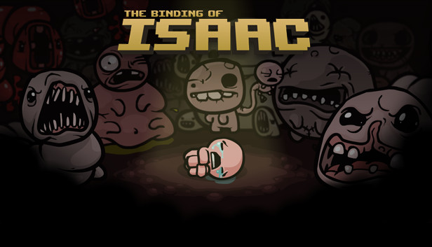
inspiration

Slide 5
inspiration
+

Slide 6

inspiration
+

Slide 7

inspiration
+

Slide 8

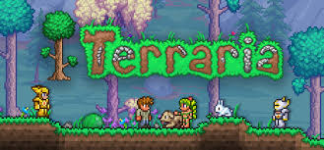
More games

Slide 9
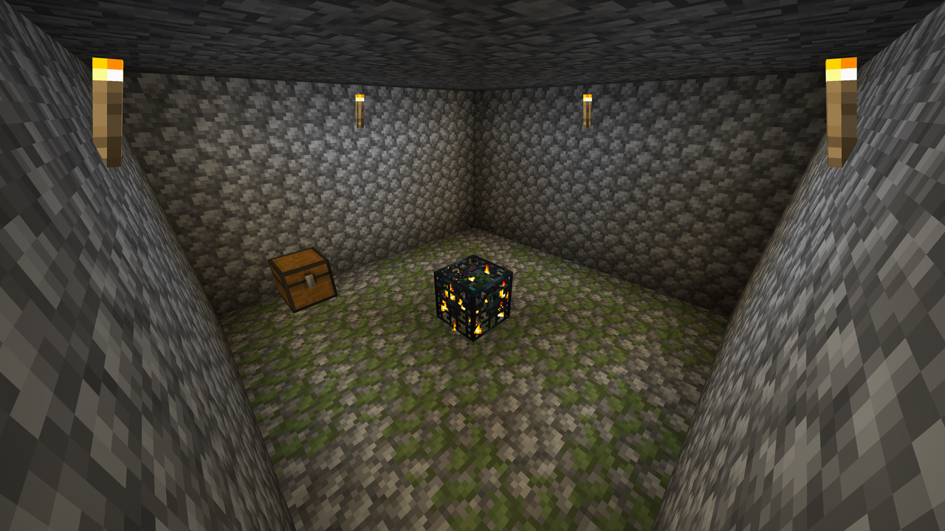

Slide 10
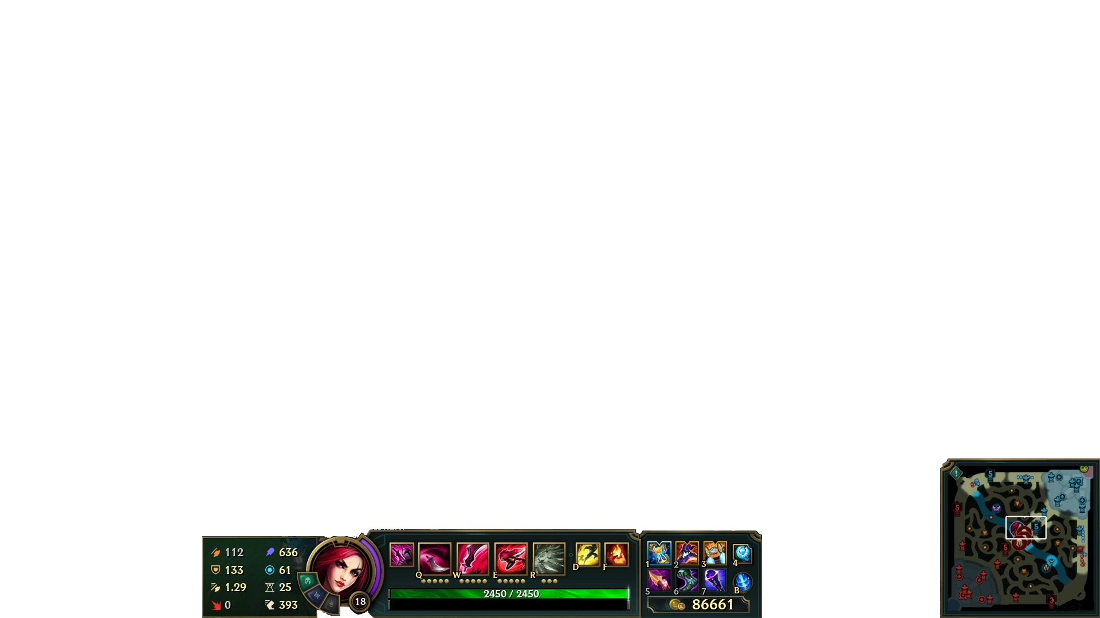

Slide 11
Gameplay

Slide 12
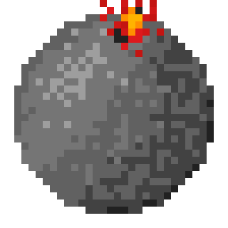

Gameplay
Abilities

Slide 13
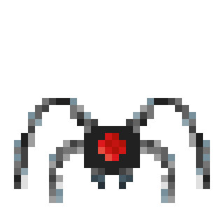

Gameplay
Abilities
Enemies

Slide 14
Gameplay
< bomb
Spider >
< Laser
Turret >
Abilities
Enemies

Slide 15
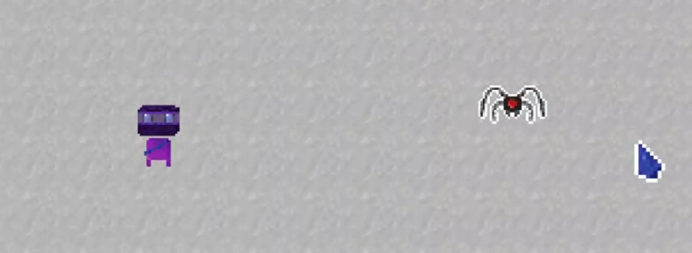
Gameplay
Q,w,e,r – abilities
Space - camera lock
Right click - movement

Slide 16
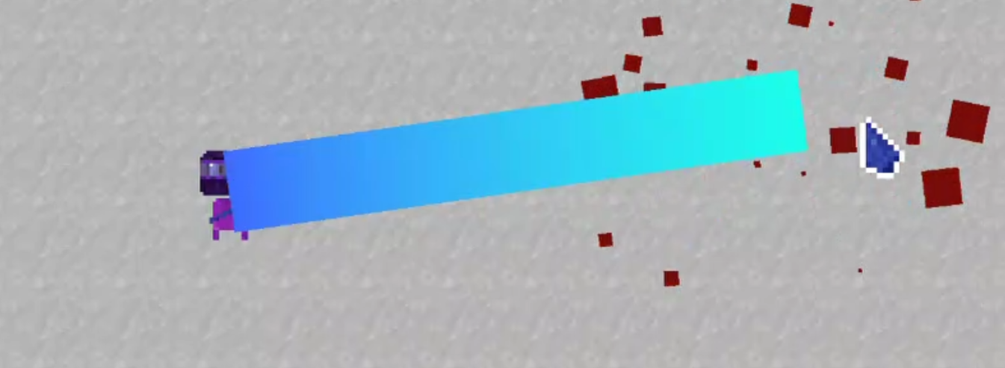
Gameplay
Q,w,e,r – abilities
Space - camera lock
Right click - movement

Slide 17
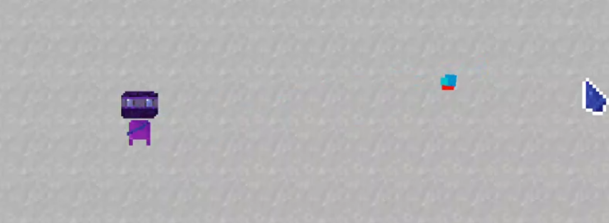

Gameplay
Q,w,e,r – abilities
Space - camera lock
Right click - movement
Laser
Mana and health drop
Score and killing count

Slide 18
GOAL
Reach final level with maximum score

Slide 19
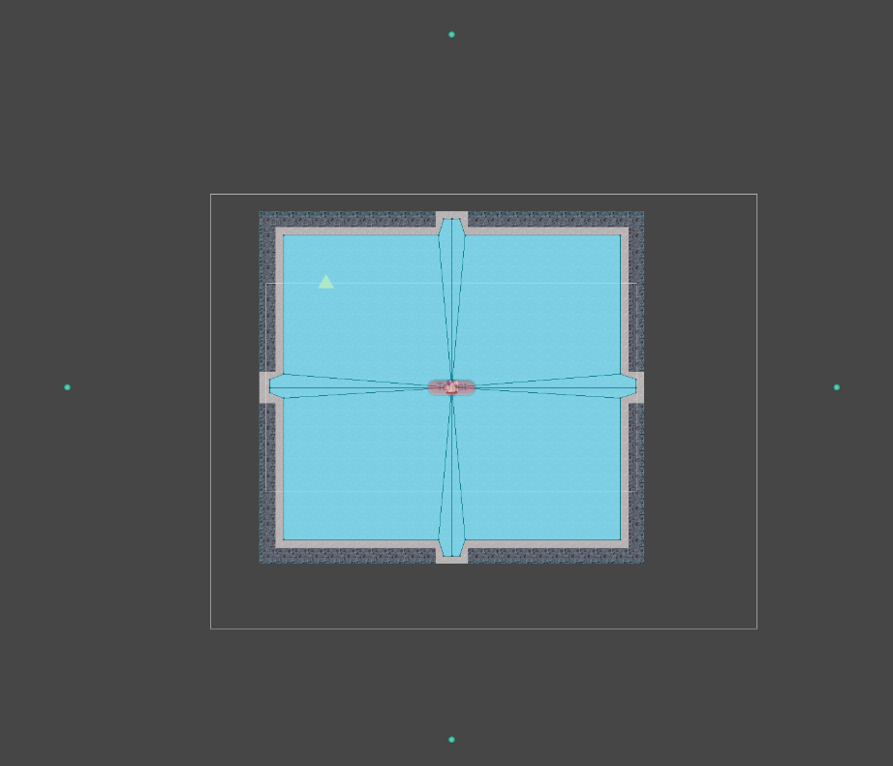
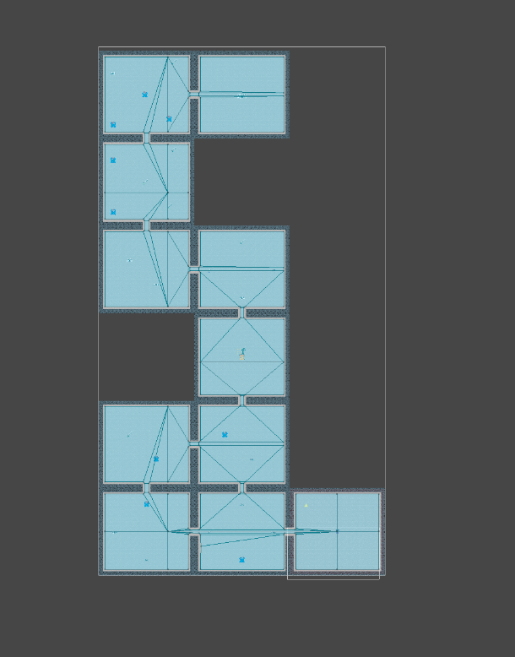
Room generation

Slide 20
Room generation
Deterministic seeds
DFS
2 layer navigation mesh
Room id

Slide 21
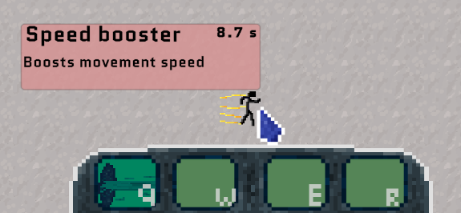
Mechanics
Moba fighting style
Effect system
Ability exchange system

Slide 22
Music
Main screen
In the dungeon
By Alexander Devinizov

Slide 23
Demo

Slide 24
Main focus
System
Style
gameplay

Slide 25
Things that are lacking
Game feel - effects
More enemies and bosses
Better ai
Balancing

Slide 26
Any questions?

